Slide 1

STEC Nueces Green Ammonia Load Project (25RPG016)
Project Overview for ERCOT RPG July 29, 2025

Slide 2
Project Overview
The proposed project aims to support a new 1,150 MW Ammonia Plant Load in Nueces County load serving station to be named Farias connected to AEP's Lon Hill to Reforzer 345 kV line
The interconnection study for the proposed load has identified transmission system reliability criteria violations per Section 4 of the EROCT Planning Guide (EPG)
STEC evaluated two (2) transmission system improvement options to address reliability issues and support the new load addition.
Based on the analysis performed, STEC identified Option 2 as the preferred option
Tier 2 project estimated to cost $74 million with an estimated in-service date (ISD) of June 2027

Slide 3
Project Overview
Option 2, the preferred option, comprises of the following transmission system improvements.
Build a new 345 kV load serving station called Farias connected to AEP's Lon Hill to Reforzer 345 kV line
Loop the Lon Hill to Grissom 345 kV line into Farias
Adds approximately 5.9 miles of new transmission lines
Requires new ROW and CCN.
Loop results in two line segments:
Lon Hill - Farias: ~4.84 miles, 345 kV, rated 1057 MVA (normal) / 1195 MVA (emergency)
Farias - Grissom: ~32.28 miles, 345 kV, rated 1057 MVA (normal) / 1195 MVA (emergency)
Lines must be placed on separate structures to mitigate P7 (N-1) contingency exposure

Slide 4
Project Need
Addresses the violations under NERC and EPG criteria contingencies, and ensures reliable integration of the proposed 1150 MW Load
Violations Observed in the initial stead state assessment include
P1, P5, and EPG section 4.1.1.8 contingency event violations observed in summer peak (SP) and Minimum Load (off-peak) conditions
Based on the results of STEC’s assessment, the facility voltage deviation/low voltage violations at the Farias station will need to be mitigated

Slide 5
Study Methodology Overview
ERCOT 2023 Steady State Working Group (SSWG) 2025SP, 2027HRML, and 2028SP cases were utilized for assessment
Incremental topology changes are incorporated to derive the study cases for the assessment:
All off-cycle IDEVs that have been posted to the ERCOT MIS after the release date of the starting cases were applied.
Any resources in the study area that met Section 6.9(1) requirements of the ERCOT Planning Guide not already modeled in the cases.
Reliability assessment was performed for the cases outlined above under the following conditions:​
P0 (normal operating conditions)
N-1 (P1, P2.1 and P7/ERCOT1 contingency conditions)
Bus Fault, Internal Breaker Fault, Breaker Failure, and Relay Failure conditions (P2.2, P2.3, P4, P5)
ERCOT2 (G-1+P7/ERCOT1)
N-G-1 (P3) conditions (G-1 + N-1)
N-A-1 (ERCOT3) conditions (300+/100+ kV A-1 + N-1)N-1-1 (P6)
P7-ERCOT98+P7
P1+P7
P7-ERCOT98+P1

Slide 6
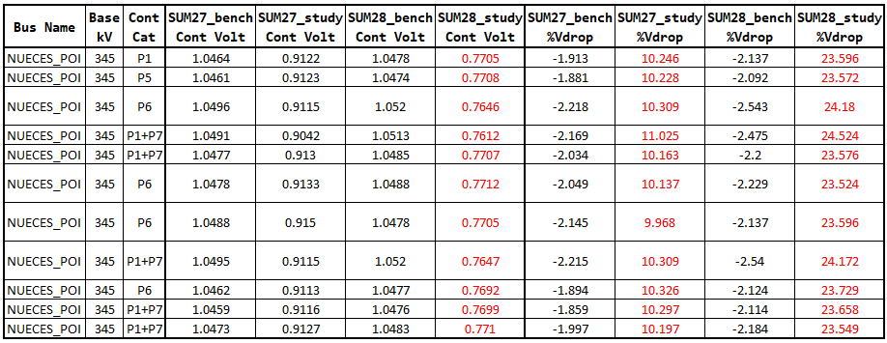
Study Results Summary
Summer Peak Voltage Violations
Nueces_POI in the table refers to the 345 kV bus at the proposed Farias station

Slide 7
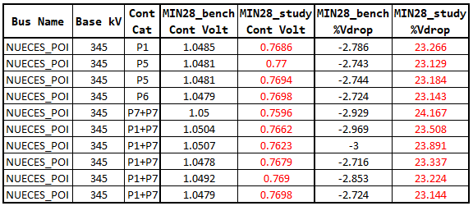
Study Results Summary Cont’d
Minimum Load Voltage Violations

Slide 8
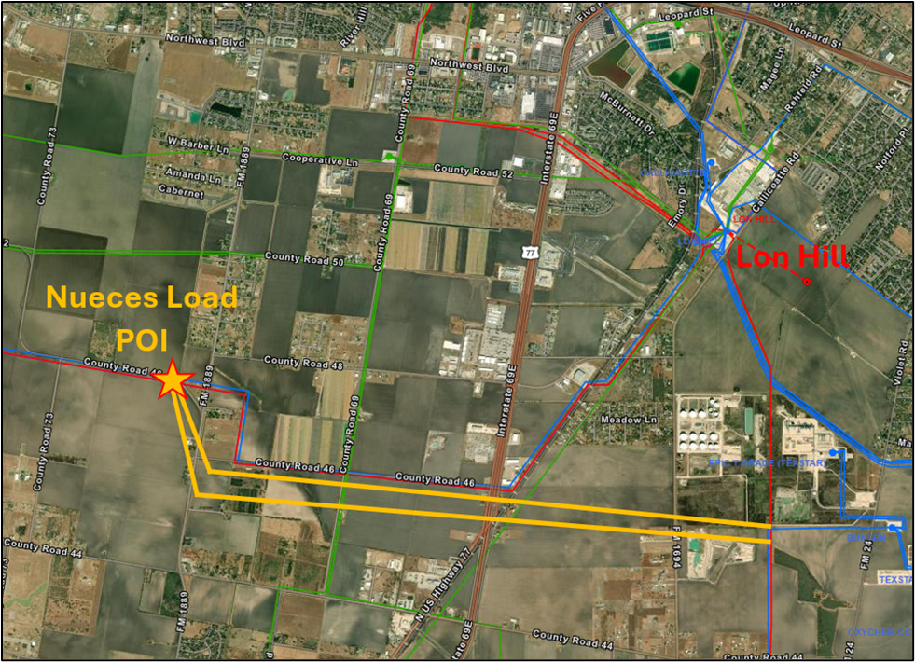
Option 1 – Loop to Nelson Sharpe 345 kV Line
Build a new 345 kV load serving station named Farias connected to AEP's Lon Hill to Reforzer 345 kV line (shown as "Nueces Load POI in the maps)
Loop the Lon Hill to Nelson Sharpe 345 kV line into the Farias station
Adds approximately 8.64 miles of new transmission lines (route illustrated in yellow)
Require new ROW and CCN
Loop results in two new line segments:
Lon Hill - Farias: ~6.05 miles, 345 kV, rated 1998 MVA (normal) / 2405 MVA (emergency)
Farias - Nelson Sharpe: ~23.39 miles, 345 kV, rated 1998 MVA (normal) / 2405 MVA (emergency)
Lines must be constructed on separate structures to avoid P7 (N-1) common tower contingency

Slide 9
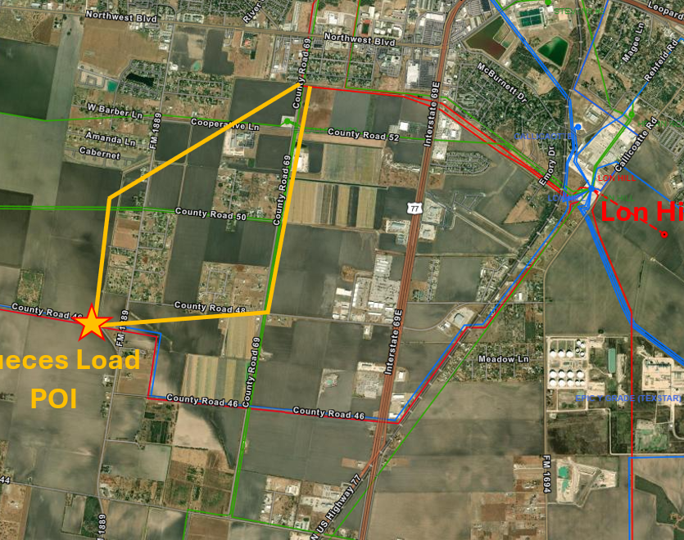
Option 2 – Loop to Grissom 345 kV line
Build a new 345 kV load serving station named Farias at the location depicted by "Nueces Load POI" on the map
Loop the Lon Hill - Grissom 345 kV line in the Farias station
Adds approximately 5.9 miles of new transmission lines
Require new ROW and CCN
Loop results in two new line segments:
Lon Hill - Farias ~4.84 miles, 345 kV, rated 1057 MVA (normal) / 1195 MVA (emergency)
Farias - Grissom: ~32.28 miles, 345 kV, rated 1057 MVA (normal) / 1195 MVA (emergency)
Lines must be placed on separate structures to mitigate P7 (N-1) contingency exposure

Slide 10
Option Performance Summary
Both options resolve all EPG reliability violations
Both options effectively mitigate low-voltage issues, enabling full 1150 MW delivery by 2027-2028
Option 2 (Grissom Loop)
Most cost-effective solution
Mitigates low voltage concerns observed under NERC and EPG criteria events for the conditions studied
Reliably integrates the proposed 1150 MW load
Requires the least amount of new greenfield transmission construction

Slide 11
Stability Assessment – Option 2
STEC used the ERCOT DWG 2023 flat-start cases and matched them to the ERCOT SSWG cases developed for the Ammonia Plant Load steady-state study, ensuring that all recent topology and load changes were accurately captured.
All summer cases utilized the DWG Summer Peak 2026 flat start case as the base case
The DWG 2027 High Renewable Minimum Load (HRML) case was used as the base case for the HRML scenarios.
STEC assessed the impact of the proposed load and incremental implementation of Option 2 on system stability, including:
Transient rotor angle stability
Voltage stability
Frequency stability
Power oscillation damping
The analysis focused on nearby transmission system performance under NERC and ERCOT planning guide events.
No transmission system stability issues were identified under any planning events with the proposed 1150 MW load connected via Option 2.

Slide 12
Short Circuit and SSR Assessment – Option 2
Short Circuit Assessment
STEC utilized the ERCOT System Protection Working Group (SPWG) 2028 FY case as the starting point of the short circuit analysis
STEC adopted assumptions consistent with the steady-state analysis to develop the short circuit study cases.
Fault duties were evaluated with and without the proposed load and assuming transmission improvements of Option 2.
No fault duty exceedances were observed for any evaluated transmission breakers owned by STEC or AEP in the study area
Subsynchronous Resonance (SSR) Screening Assessment
An SSR topology screening was performed to determine if the Proposed RPG Project created any new vulnerability to series capacitors for existing generators within the ERCOT system. The screening was performed with and without the Proposed RPG Project, and it was found that the Proposed RPG Project creates a new N-12 outage set (N-14 without the Proposed RPG Project) which creates a radial path to the AEP-owned series capacitors at Cenizo and Del Sol. Therefore, further SSR analysis may be needed for the Proposed RPG Project.

Slide 13
Summary and Recommendation
Based on the reliability study results, Option 2 is the most cost-effective and technically viable solution and therefore is STEC’s preferred option.
It addresses all reliability concerns and supports the integration of the proposed Ammonia Plant Load at its full capacity (1150 MW)
Short circuit and stability assessments did not indicate any concerns with the addition of the proposed load and the transmission improvements associated with Option 2
The preferred Option 2 will require a CCN application and is classified as a Tier 2 project
Estimated cost for Option 2 is $74 million and target completion date is June 2027

Slide 14
Questions?
Thank You!

